Slide 1
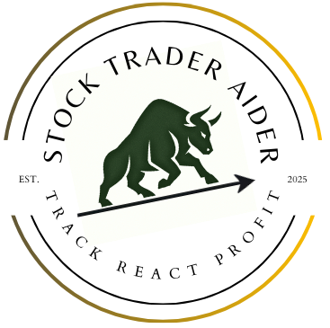
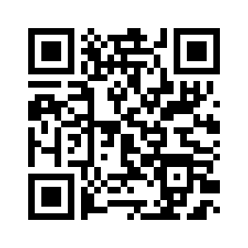
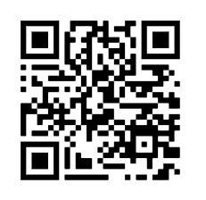


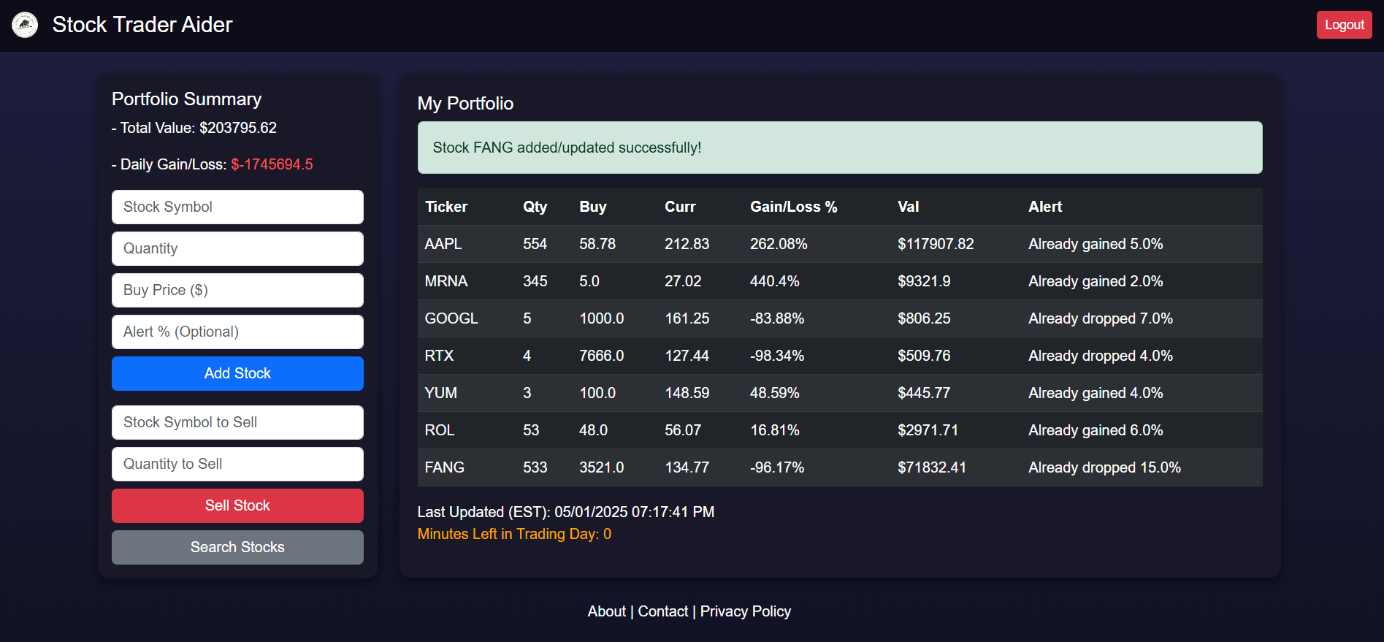
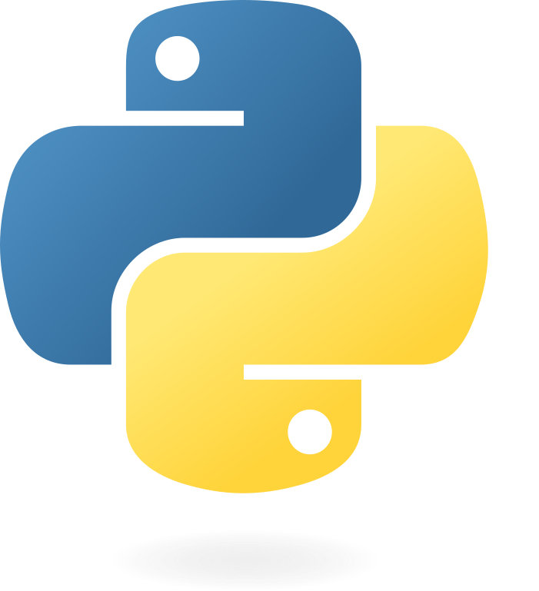
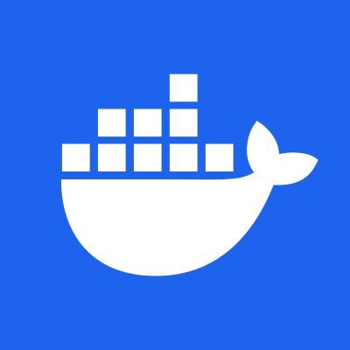

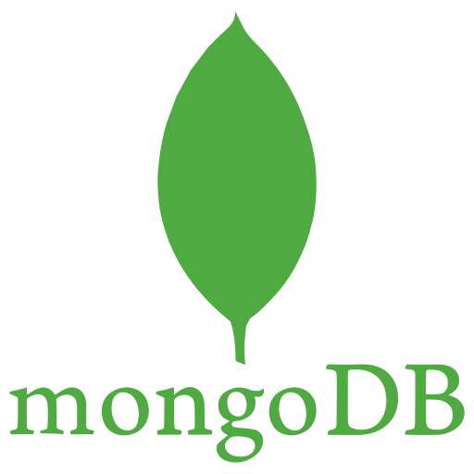
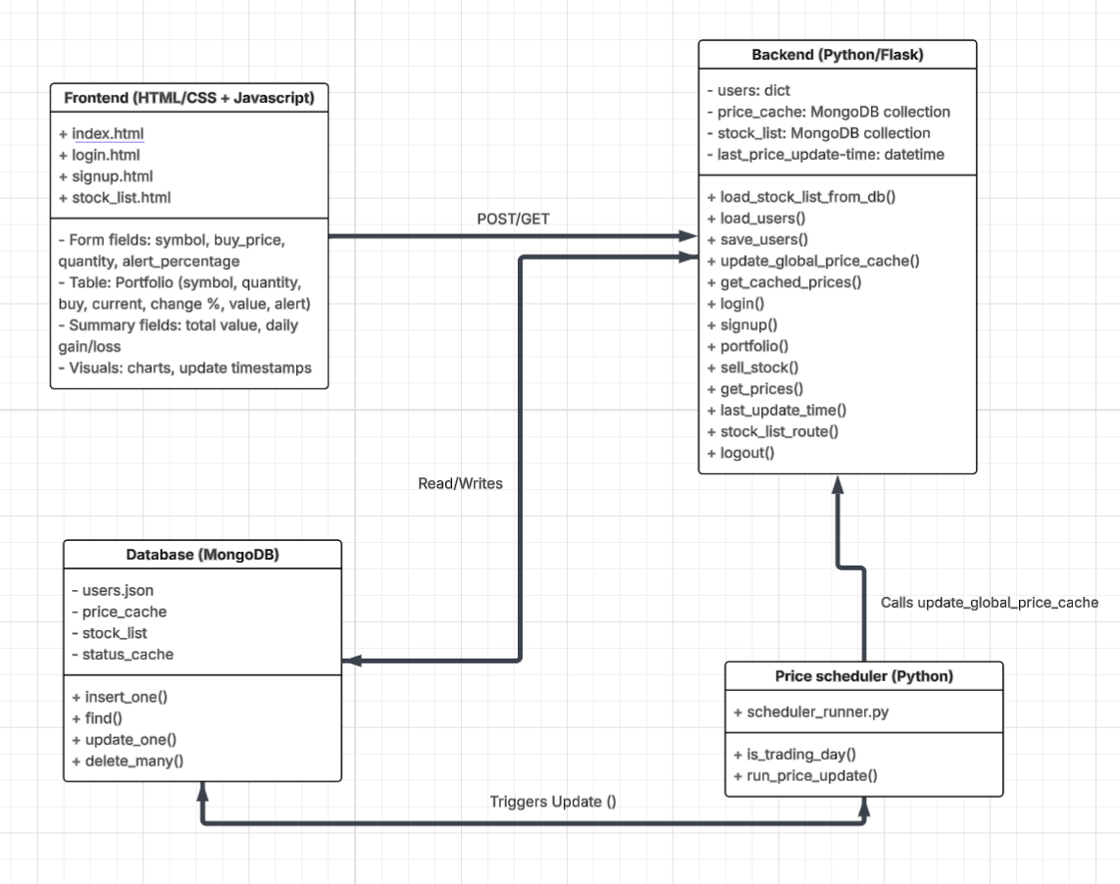
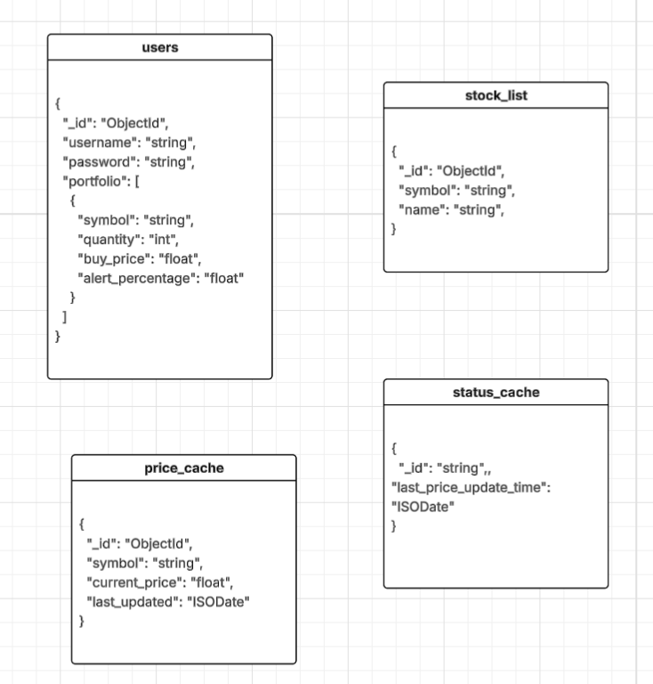
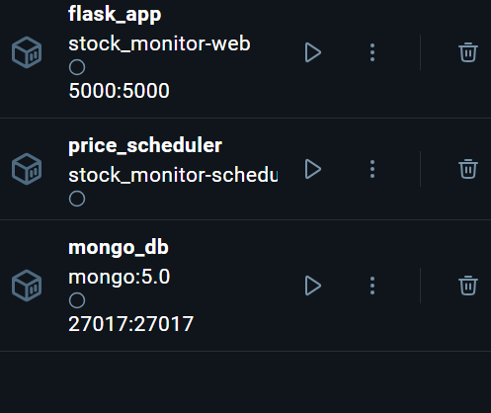
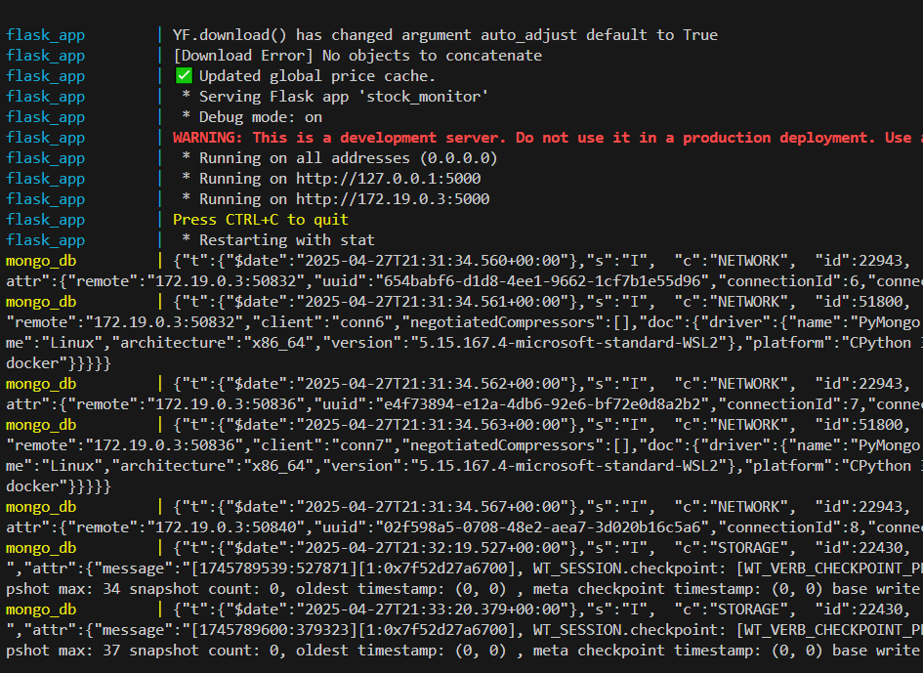
OWEN GUO
JUSTIN KERR
SAMMY MBAZANG
MICHAEL MYERS
GITHUB~
DEMO~
Overview
A streamlined stock tracker that lets users build and focus on their portfolio without the unnecessary ads, distractions, or clutter. Helping you
Track, React, Profit.
Features
Real-time portfolio tracking
Minimalist, ad-free interface
User-friendly account system
Live portfolio valuation
Custom price alert system
Architecture
price_scheduler
flask_app
mongo_db
Docker

